Slide 1
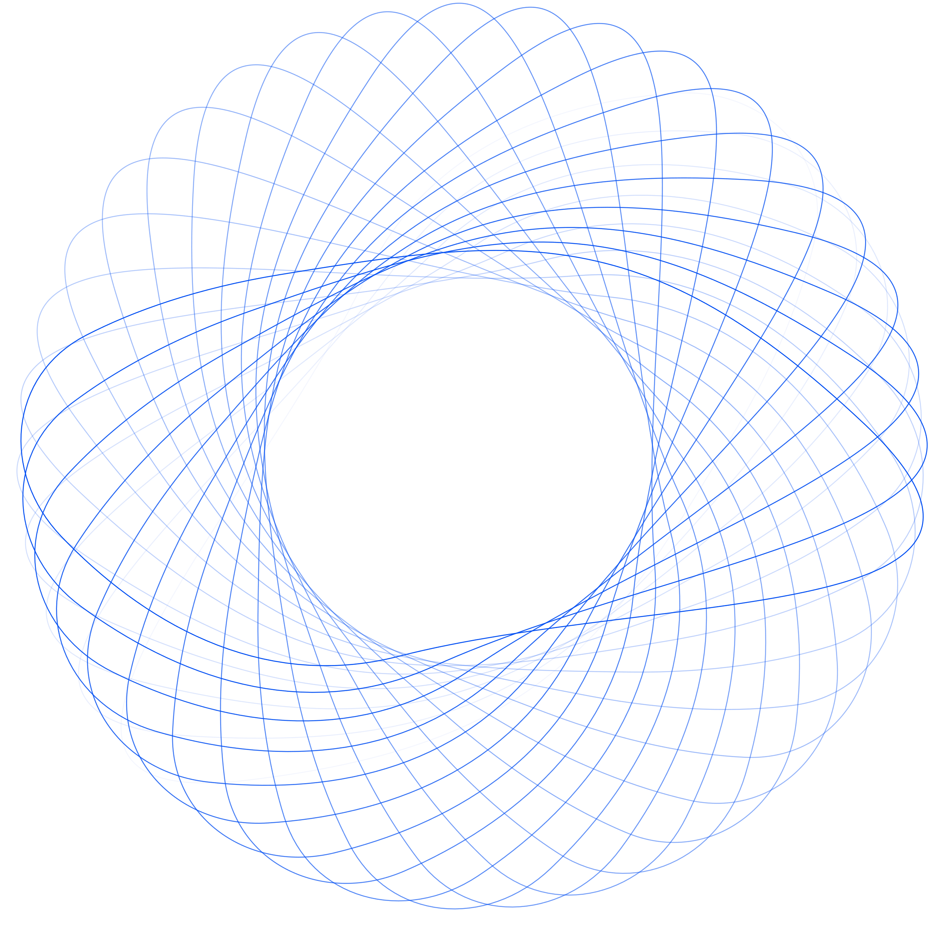



Lets Meet
Real-Time Video Conferencing Application
Submitted To
Dr. Ismat Rahman (IsR)
Mr. Palash Roy (PR)
Presented by Juliana Silva
Mr. Jargis Ahmed (JA)

Slide 2
Lets Meet
Real-Time Video Conferencing Application
Submitted By
Md. Tauseef - Ur - Rahman (FH -024)
Tamzid Bin Tariq (FH - 048)
Presented by Juliana Silva

Slide 3





List Of Content
1
Problem Domain & Motivation
2
Objectives / Aims
3
Key Features
4
Architecture / Workflow Diagram
5
Tools & Technologies
6
Applied Networking Concepts
7
Limitations & Future Plans

Slide 4

Problem Domain
Most existing video conferencing tools are:
Paid or freemium, limiting full access
Feature-heavy & complex, not beginner-friendly
Resource-intensive, poor performance on low-end devices

Slide 5
Motivation
1
2
3
Need for a lightweight, free, and customizable alternative
Build an app with real-time communication and modern UI, powered by Python
Rise of remote work, online education, and virtual meetups

Slide 6






OBJECTIVES / AIMS
Real-time video and audio communication with minimal latency.
Modern, responsive UI using PyQt6.
Features like chat, file sharing, private messaging.
Robust client-server architecture.
Run efficiently on standard hardware over LAN.

Slide 7

01
Video Streaming (240p–900p)
Audio with noise control
Key Features
02
Camera & Mic Toggle
03
Real-time Chat & file sharing
04
Modern responsive UI
05
05
Smart session & resource management

Slide 8

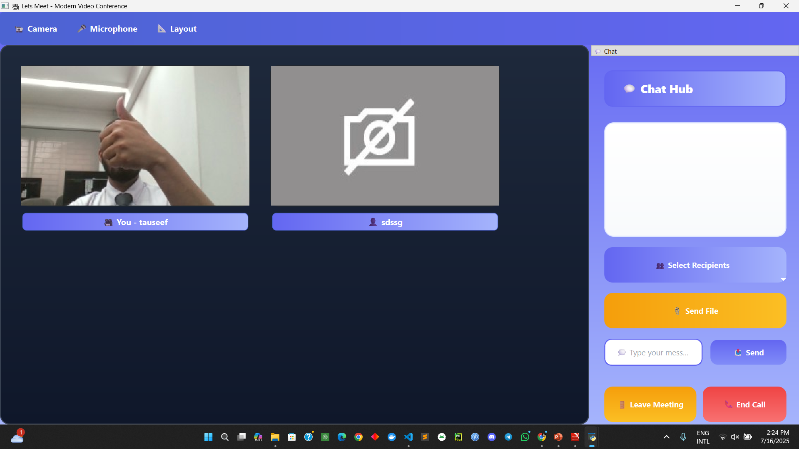

Video Conference Interface

Slide 9
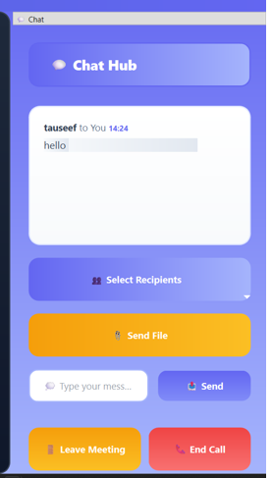
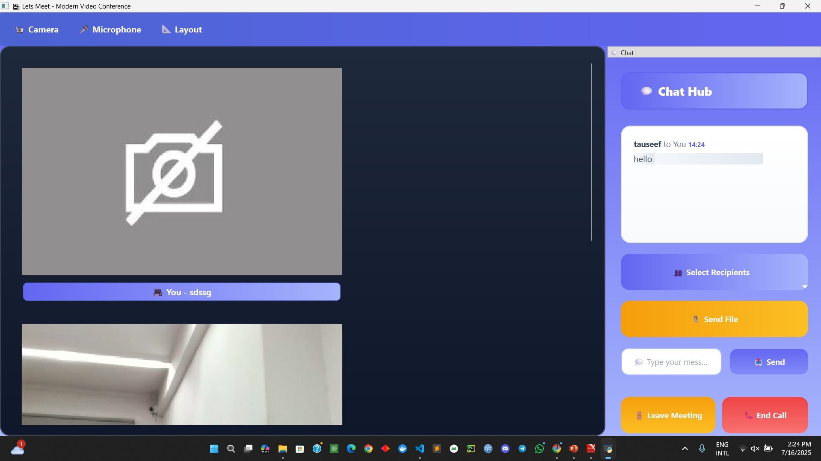
Chat box Interface

Slide 10
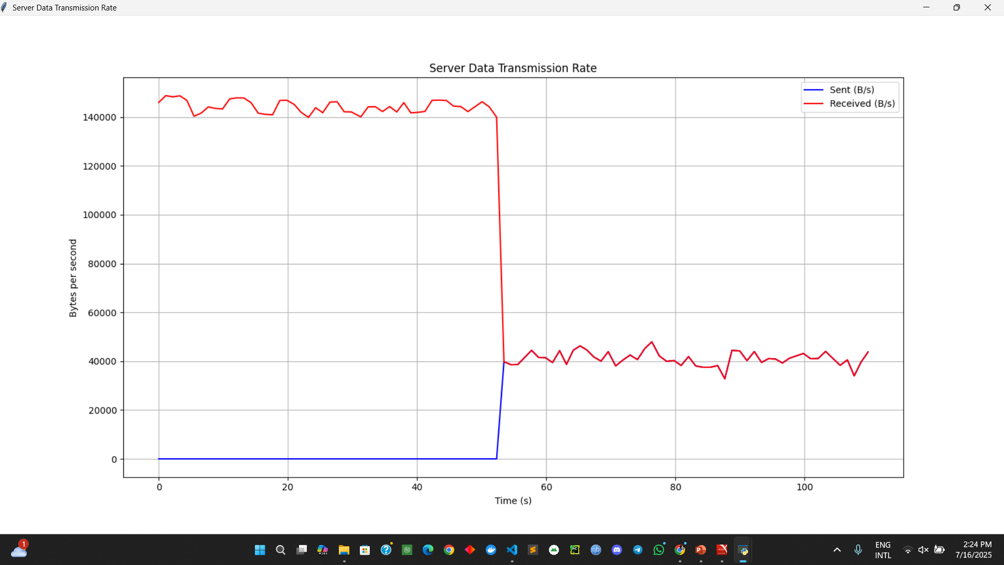
Data Rate Graph

Slide 11
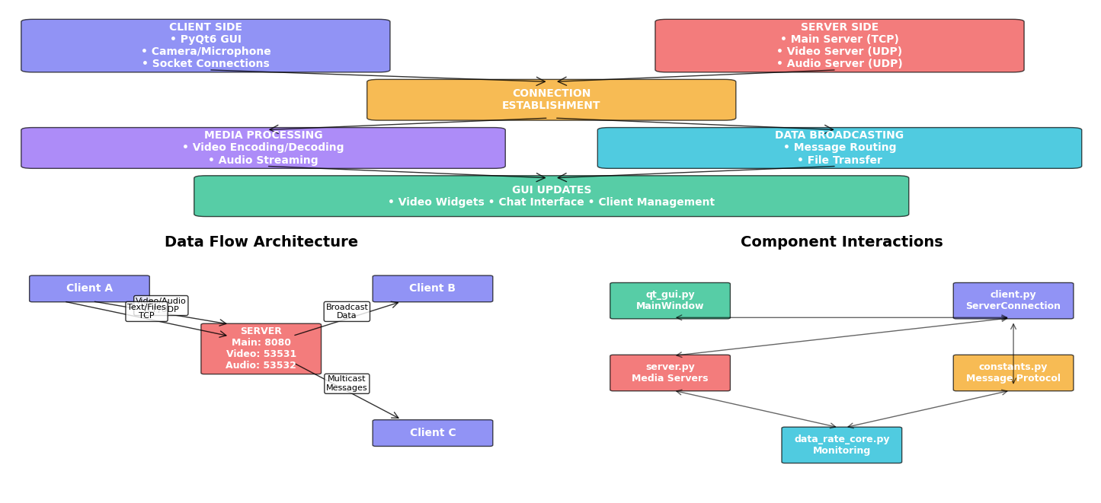
Workflow

Slide 12
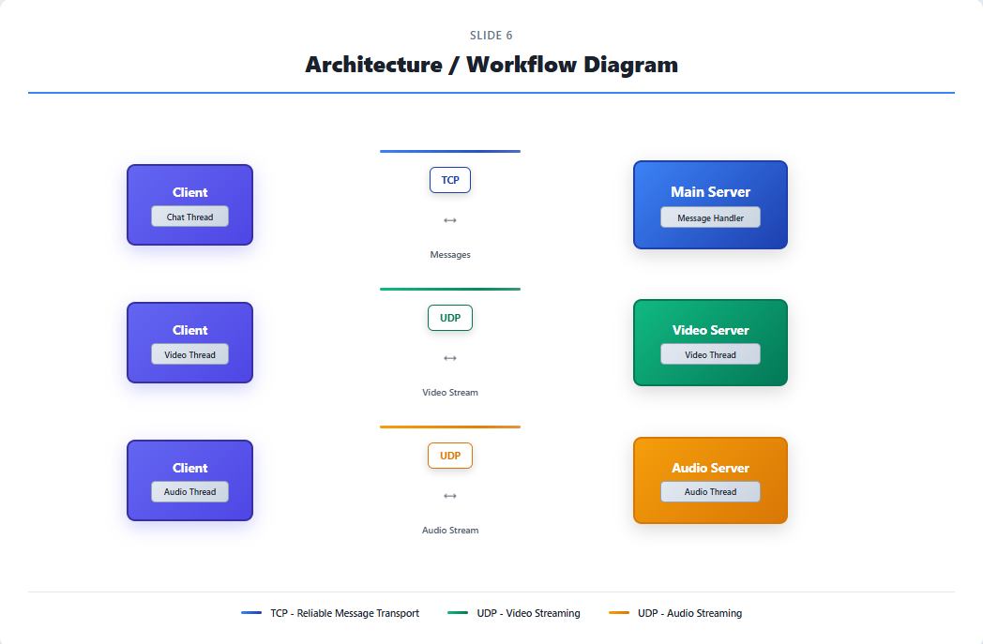

System Architecture Diagram

Slide 13












TOOLS & TECHNOLOGIES
Language
01
GUI Framework
03
Video
05
Python 3.8+
PyQt6
OpenCV
Audio
Networking
Others
NumPy, threading, OS modules
PyAudio
Socket Programming (TCP/UDP)
02
04
06

Slide 14


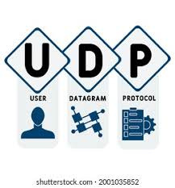

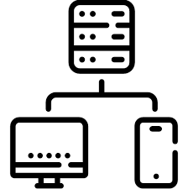
Applied Networking Concepts
TCP (Main Server)
UDP
Socket Programming
Client-Server Architecture:

Slide 15
TCP – Reliable Communication (Main Server)
Key Features:
Used for: Chat messages & file sharing
Reliable Data Transfer: Ensures messages/files arrive in order and without errors
Flow Control: Prevents the sender from overwhelming the receiver
Congestion Control: Dynamically adjusts sending rate to avoid network overload
Ensures smooth, consistent communication between participants

Slide 16
UDP – Real-Time Streaming (Audio & Video Servers)
Key Features:
Used for: Video and audio streaming
Low-Latency: Streams data quickly, minimizing delay
No retransmission: Accepts occasional packet loss to maintain real-time experience
Ideal for applications where speed matters more than perfection
Each client directly connects to Video/Audio Servers via UDP sockets

Slide 17
Socket Programming & Threading
Key Features:
Sockets: Enable direct communication between clients and servers
Multithreading: Separate threads for video, audio, and text/file messaging
Ensures all streams run concurrently without blocking
Non-blocking I/O techniques used to manage real-time responsiveness
Implemented using Python's built-in socket and threading libraries

Slide 18
Modular Client-Server Architecture
Key Features:
Client-Server Design:Each client connects to 3 independent servers (Main, Video, Audio)
Makes the system clean, maintainable, and extendable
Scalability:More clients can be added without redesign
Ideal setup for future upgrades like encryption or load balancing

Slide 19

01
LAN-Only Support
Limitations
Lack of End-to-End Encryption
02
Basic Error Handling
03
04
Manual Configuration
05

Slide 20
Future Plans & Improvements
Add Security Features
Cross-Platform Clients
WebRTC Integration
Performance Optimization
Implement TLS/DTLS for encrypted communication and safer data transfer
Develop mobile versions using Kivy (Python) or Flutter
Enable browser-based conferencing without installing software
Add bitrate adaptation, media compression, and usage monitoring

Slide 21

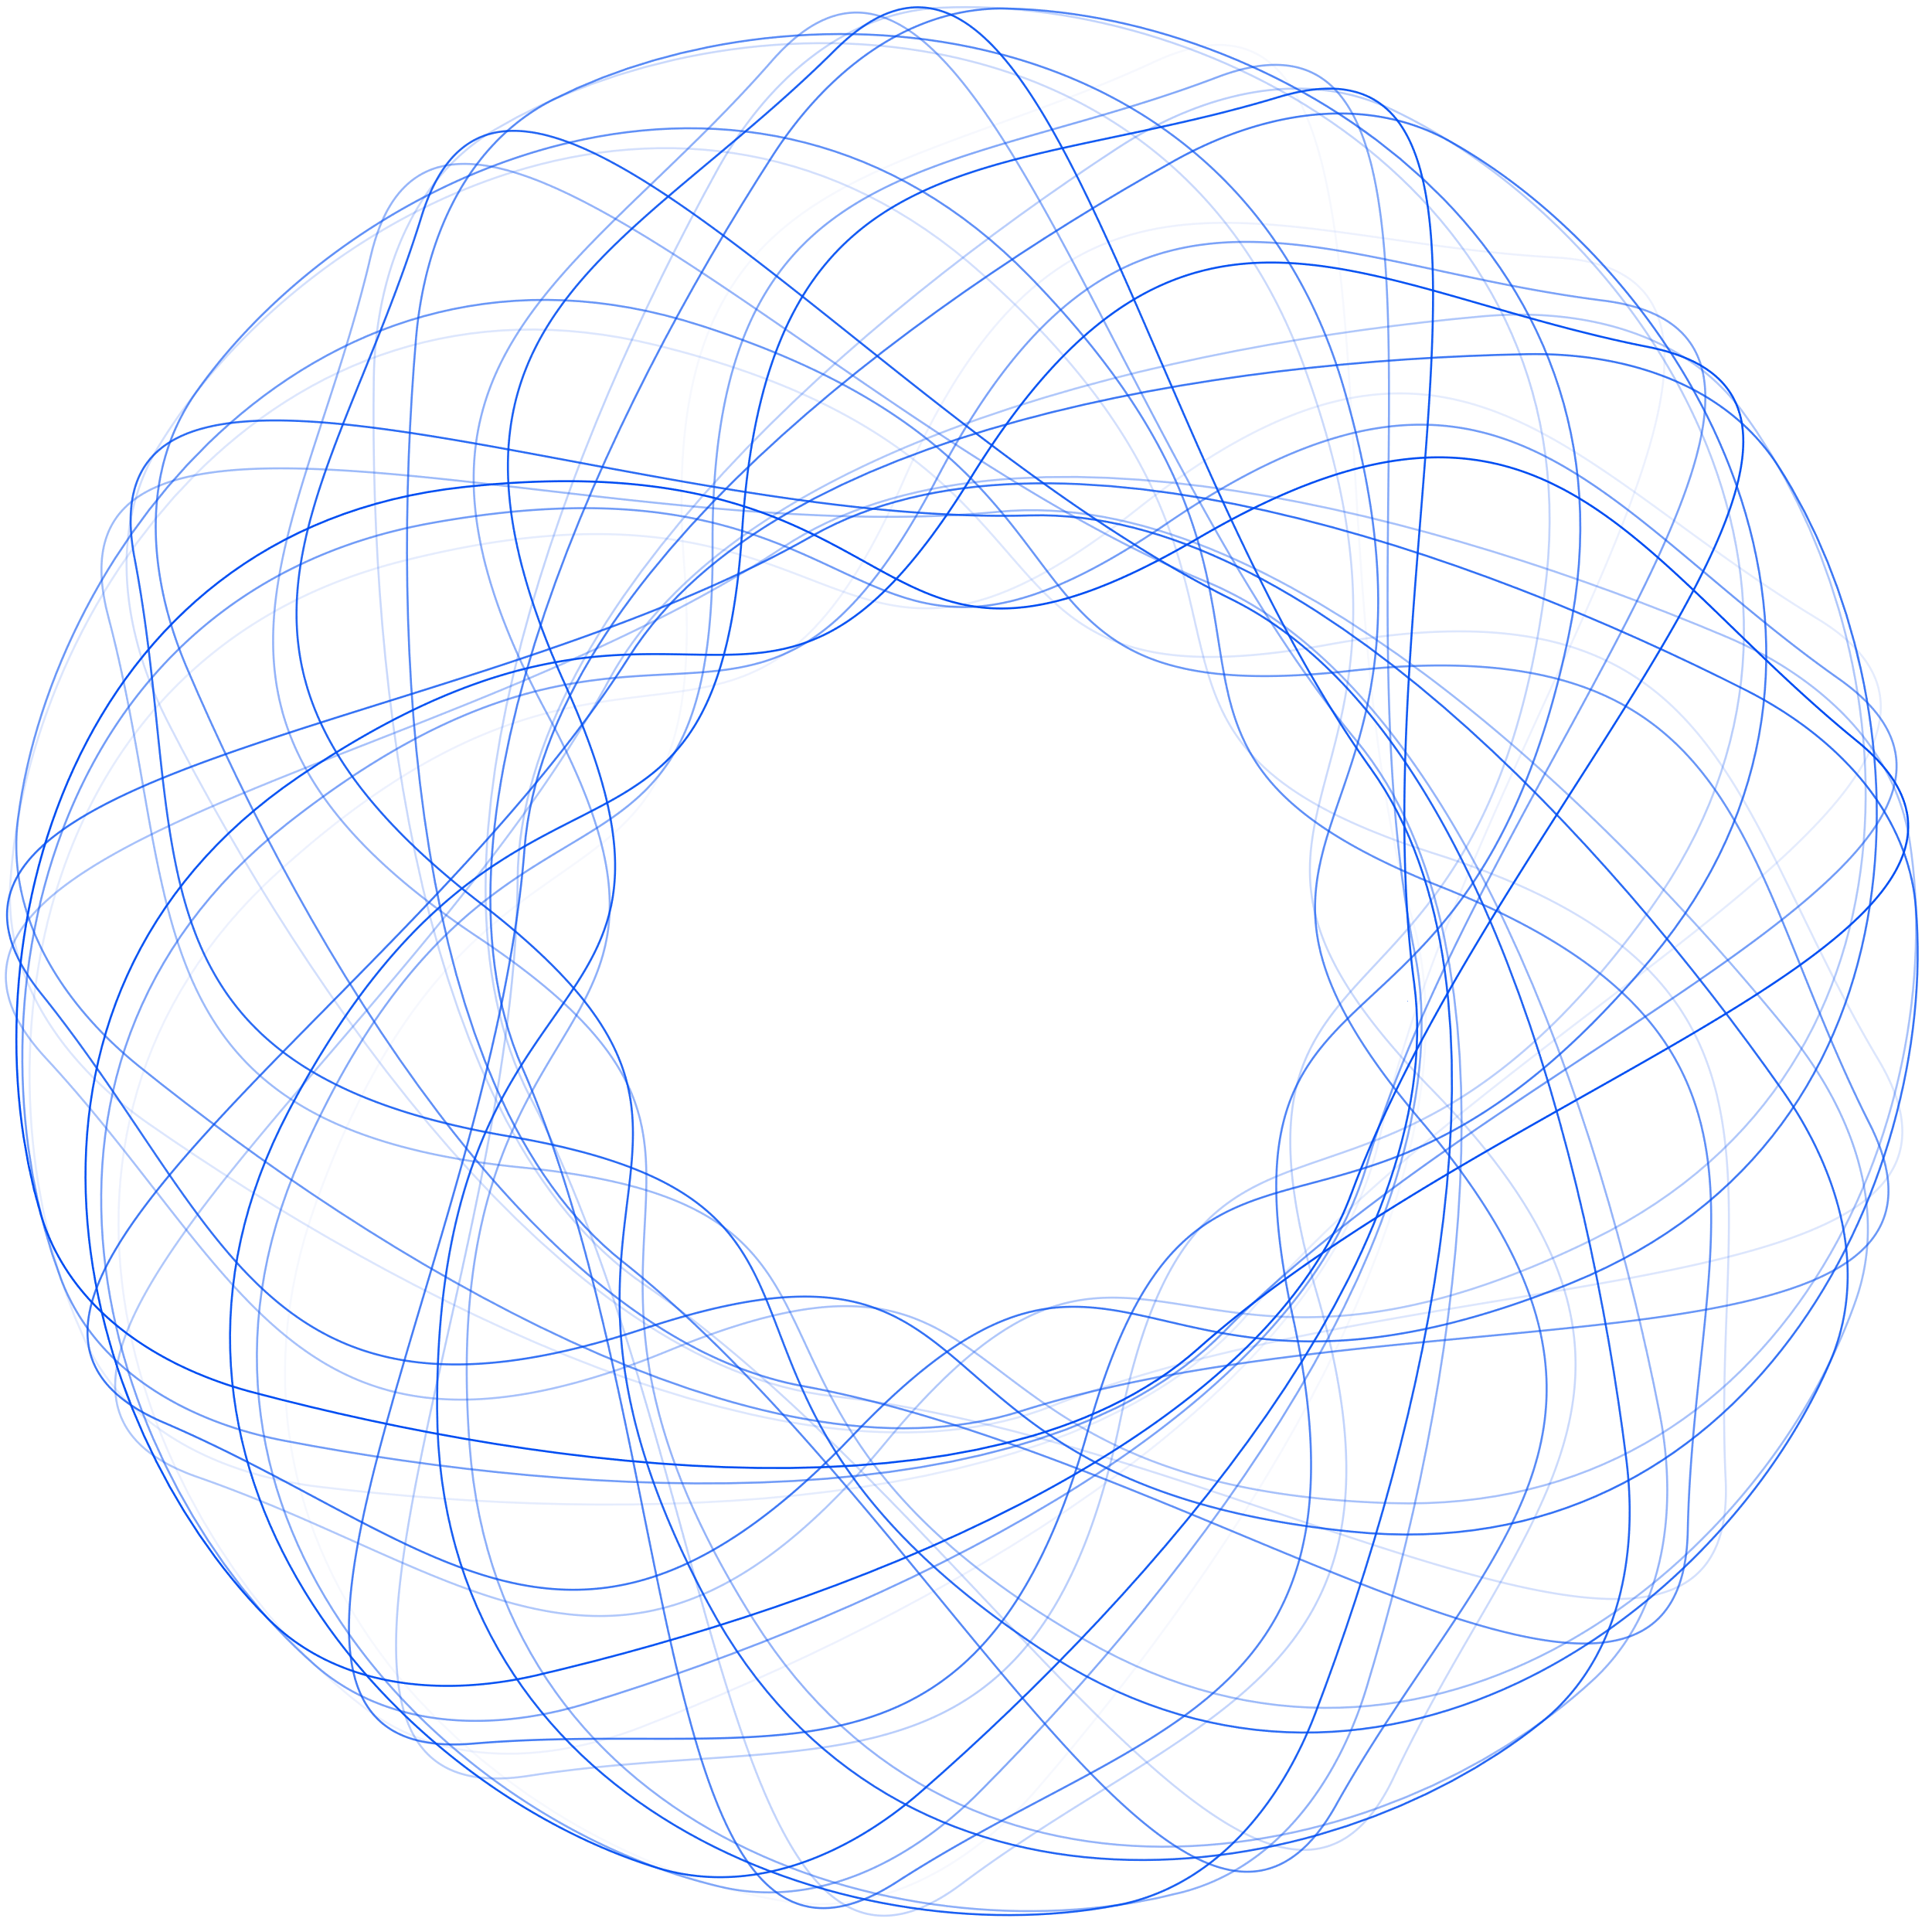

Conclusion
1
We successfully developed a real-time video conferencing application using Python and socket programming.
2
Applied key networking concepts: TCP (reliable messaging), UDP (real-time media), multithreading, and client-server architecture.
3
Delivered modern UI features: video/audio chat, messaging, file sharing, dynamic layouts.
The system is modular and scalable, with a clear roadmap for future enhancements like encryption, WebRTC, and mobile support.
4

Slide 22
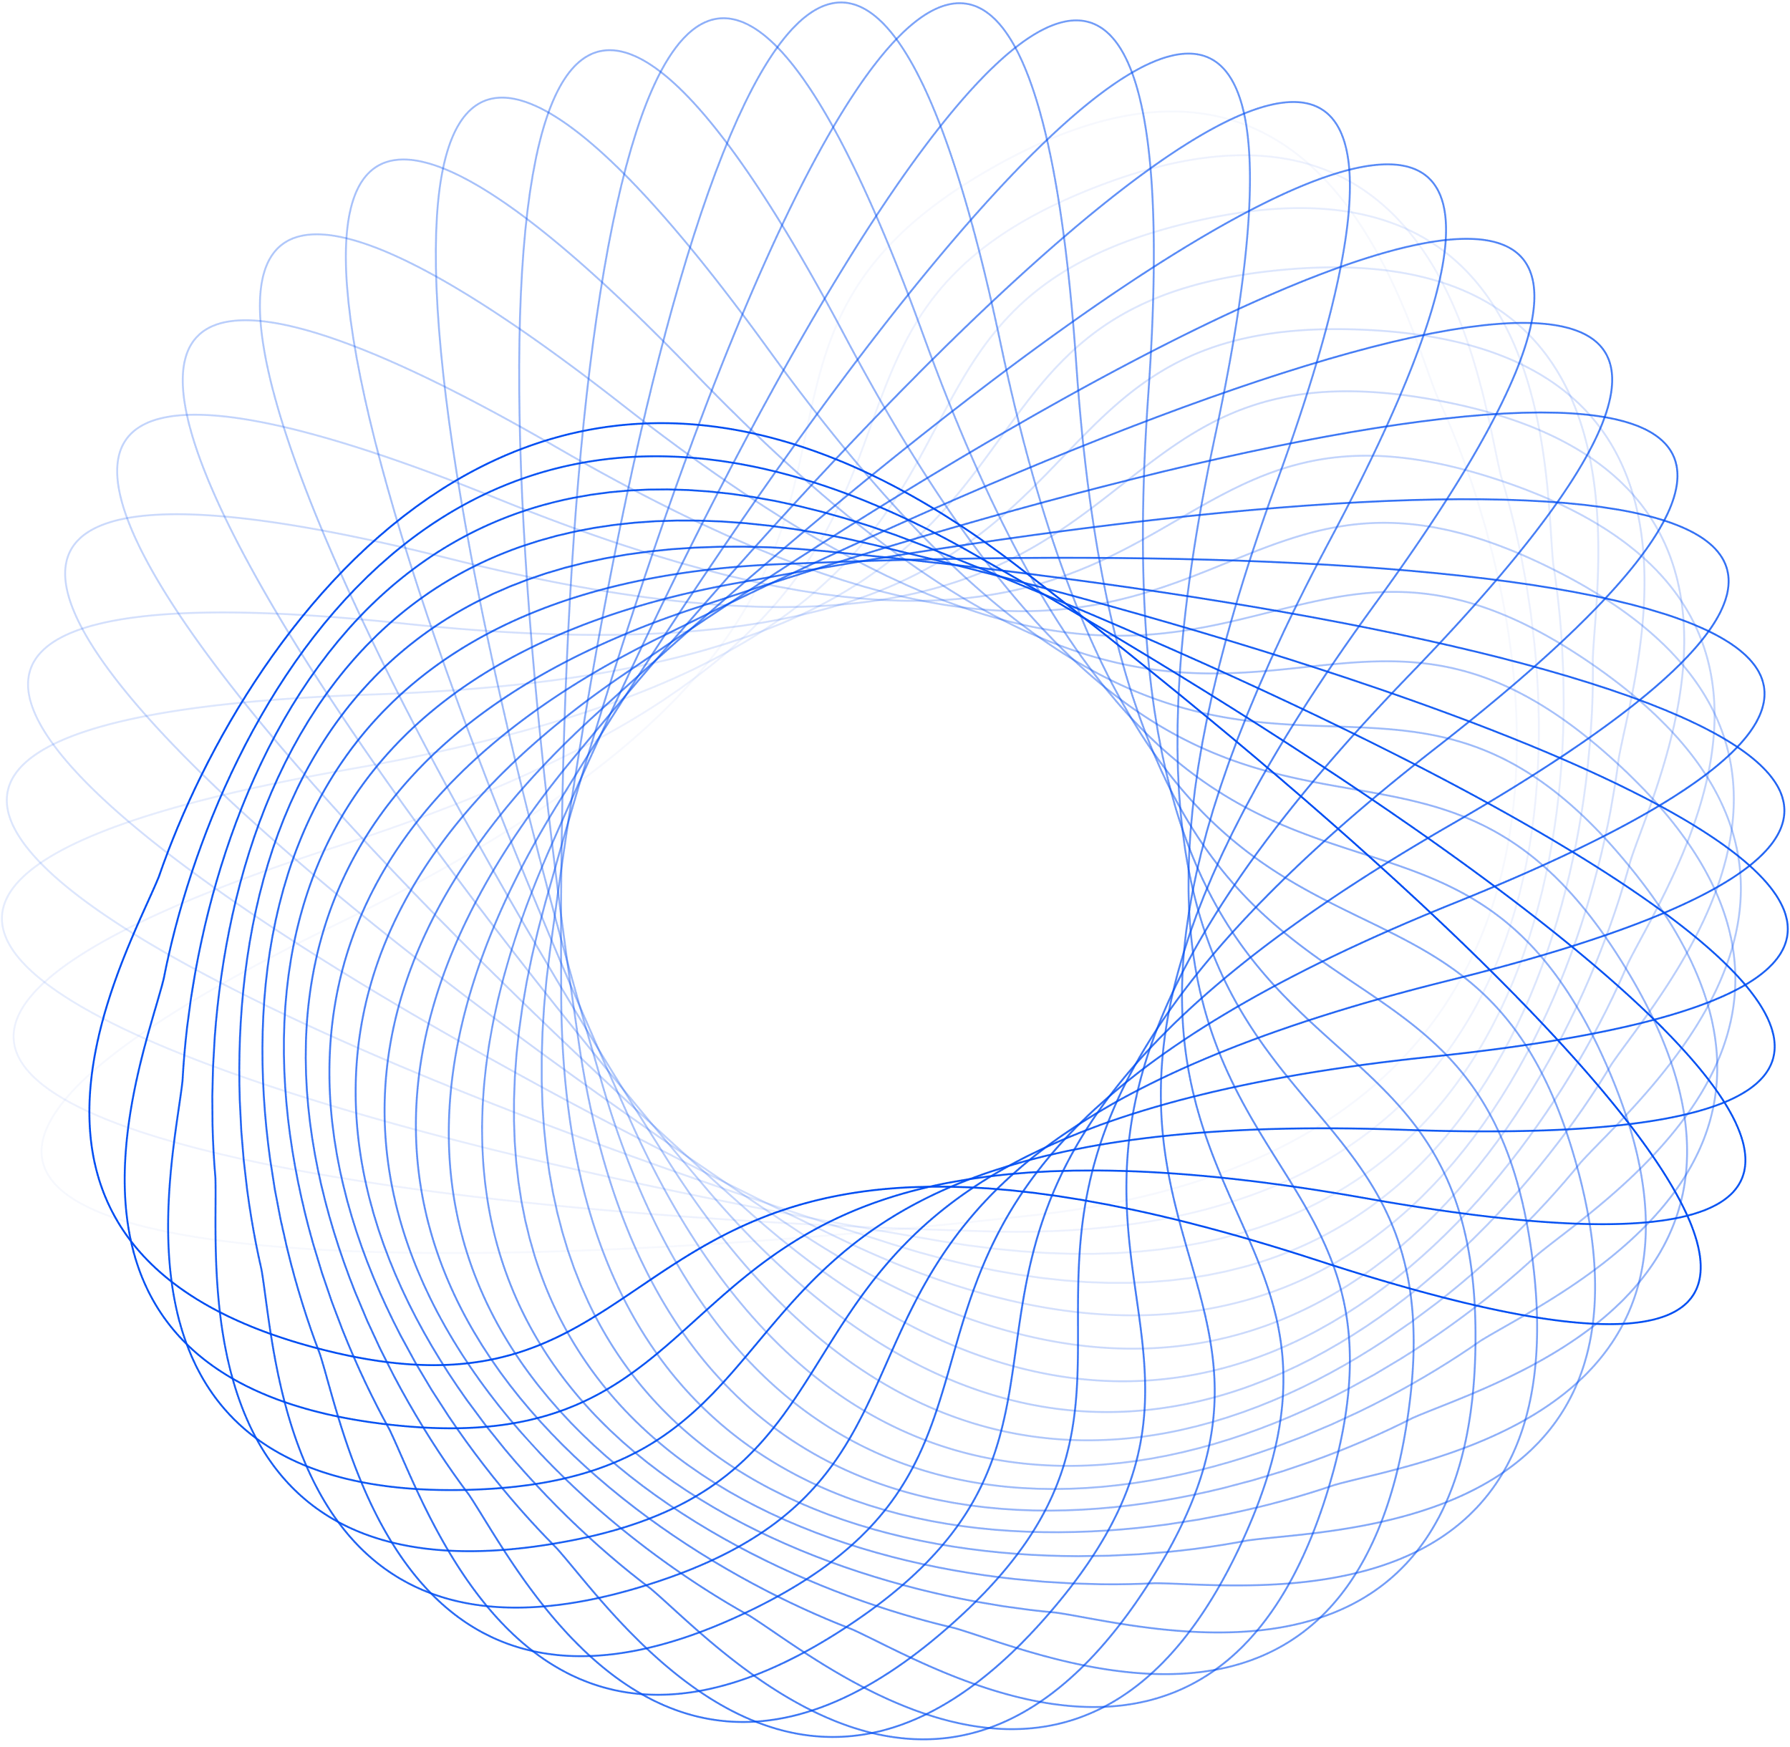

Thank You For
Your Attention!

